Slide 1

Disease-Gene Prediction: A Machine Learning Perspective
by
Mounika D
Roll No. 214G1A3256
Likitha B
Roll No. 214G1A3246
Jayanth Babu G
Roll No. 214G1A3233
Navya Teja G
Roll No. 214G1A3263
Under the guidance of
Mrs. V. Kamakshamma, _{M. Tech., (Ph.D)}
Assistant Professor
Department of Computer Science and Engineering (Data Science)
Srinivasa Ramanujan Institute of Technology
(Affiliated to JNTUA & Approved by AICTE) (Accredited by NAAC with ‘A’ Grade & Accredited by NBA (EEE, ECE & CSE)
Rotarypuram Village, B K Samudram Mandal, Ananthapuramu – 515701.
2024 - 2025

Slide 2

Contents
Abstract
Problem Statement
Objectives of Project
Literature survey
Proposed Work
Existing system vs Proposed system
Planning

Slide 3
Contents
Requirements
UML Diagrams
Data Preprocessing Techniques
Sample Code
Screenshots (project)
References
GitHub Link

Slide 4
Review – 0 Remarks and Queries
Show whether the particular accuracy value is achieved.
How algorithms handle large datasets.

Slide 5
Abstract
Understanding the intricate relationship between genes and genetic diseases is pivotal for advancing human health. This project proposes computational methods to identify disease-associated genes as a cost-effective and efficient alternative to traditional experimental approaches. The research focuses on using techniques that integrate advanced topological and biological features to enhance gene-disease association predictions. Leveraging disease-gene data from DisGeNET, the methods are evaluated using performance metrics such as true positive rate, false positive rate, precision, recall, accuracy, F-measure, and ROC curve analysis. Among the computational models, the Extreme Gradient Boosting Algorithm (XGBoost) and Random Forest are anticipated to deliver superior results, with Random Forest achieving the highest accuracy of 97.81%, particularly in major disease classifications such as Group, Disease, and Phenotype. The findings aim to establish the efficacy of these techniques in surpassing existing state-of-the-art methodologies, paving the way for advancements in computational genetics.
Keywords: Gene-disease association, DisGeNET, computational genetics, XGBoost, topological features, biological features, performance metrics, machine learning.

Slide 6
Problem Statement
The complexity and vast scale of genetic data present challenges in identifying associations between genes and diseases. Traditional, manual methods are time-consuming, prone to errors, and fail to scale efficiently with large datasets. There is a critical need for automated and scalable solutions to process genomic data and uncover gene-disease relationships with greater accuracy and speed. Machine learning provides a path forward by addressing these challenges.

Slide 7
Objective of the Project
To develop a machine learning web application for accurate gene-disease prediction, integrating advanced models with an intuitive interface to aid early diagnosis in healthcare.

Slide 8
Literature Survey
No | Title | Author | Journal Name & Year | Methodology Adapted | Key Findings | Gaps
1. | Prediction and Validation of Gene-DiseaseAssociations using Methods Inspired by Social Network Analyses | U. M. Singh-Blom, N. Natarajan, A. Tewari, J. O. Woods, I. S. Dhillon, E. M. Marcotte | The journal name is PLoS One,2013 | Social Network Approaches | Developed methods for predicting gene-disease associations based on social network analysis, validated with known associations. | Focuses on predicting gene-disease links but lacks integration with modern machine learning models, limiting accuracy.
2. | Identifying potential association on gene-disease network via dual hypergraph regularized least squares | H. Yang, Y. Ding, J. Tang, F. Guo | The journal name is BMC Genomics,2021 | Network-Based Methods | Proposed a dual hypergraph regularized least squares method for identifying gene-disease associations, enhancing prediction accuracy | Offers robust gene-disease network predictions but lacks flexibility in incorporating non-network-based genomic data.

Slide 9
Literature Survey
No | Title | Author | Journal Name & Year | Methodology Adapted | Key Findings | Gaps
3. | XGDAG: Explainable Gene–Disease Associations via Graph Neural Networks | Andrea Mastropietro, Gianluca De Carlo, Aris Anagnostopoulos | Bioinformatics, 2023 | Graph neural networks (GNNs) combined with positive-unlabeled (PU) learning and explainability techniques | XGDAG surpasses existing methods in identifying disease-associated genes, validated by curated datasets and significant enrichment analyses. | The methodology's performance depends on data quality and requires improvements in PU learning, GNN explainability, and multi-omics integration.
4. | A deep learning framework for predicting disease-gene associations with functional modules and graph augmentation | X. Jia et al. | The journal name is BMC Bioinformatics, 2024 | Deep Learning methodology | Introduced a deep learning framework using functional modules and graph augmentation for improved gene-disease prediction. | Deep learning provides high accuracy but struggles with resource intensity and scalability when applied to large-scale genomic datasets

Slide 10
Proposed Work
The proposed system for gene-disease association prediction begins with comprehensive data preprocessing, including handling missing values, encoding categorical data, and using KMeans clustering to group diseases based on genetic similarities. The data is then processed through four machine learning models: Random Forest, XGBoost, LightGBM, and KNN. By comparing the performance of these models, the system ensures robust and accurate predictions. The best-performing model is selected to predict gene-disease associations.
The system is deployed as a Flask web application, allowing users to input genetic data in real-time. The output includes predictions in three categories: Disease, Group, and Phenotype, helping researchers identify disease associations, categorize diseases, and predict phenotypic outcomes. By combining multiple models, detailed preprocessing, and a user-friendly interface, the system provides an efficient, scalable, and accessible solution for gene-disease prediction in research and clinical settings.

Slide 11
Existing System vs Proposed System
Aspect | Existing System | Proposed System
Handling Complexity | Cannot fit for complex data | Suitable for complex data with advanced techniques
Model Accuracy | Gives less accuracy due to more errors in models | Improved accuracy with optimized models (e.g., Random Forest achieving 97.81%)
Preprocessing | Basic preprocessing used | Advanced preprocessing: imputation, label encoding, KMeans clustering
Processing Approach | Likely batch processing or offline | Real-time predictions via Flask web application

Slide 12
Planning
Phase 1: Literature Survey
Research: Review, Methods, Approaches
Phase 2: Data Collection
Sources: DisGeNET
Collection: Curated, Reliable
Phase 3: Data Preprocessing
Tasks: Imputation, Encoding, Normalization, Feature Selection, KMeans Clustering
Phase 4: Model Training
Models: Random Forest, XGBoost, LightGBM, KNN
Tuning: Hyperparameters, Cross-validation

Slide 13
Planning
Phase 5: Model Evaluation
Metrics: Accuracy, Precision, Recall
Assessment: Robustness, Performance
Phase 6: System Integration
Components: Backend, Frontend, Flask
Integration: Communication, Deployment
Phase 7: Testing
Tasks: Validation, Bugs

Slide 14
Requirements
S/W CONFIGURATION:
Operating System : Windows 7/8/10
Server side Script : HTML, CSS, Bootstrap & JS
Programming Language : Python
Libraries : Flask, Pandas, MySQL. Connector, Tensor flow, Keras
IDE/Workbench : VS Code
Technology : Python 3.8+
Server Deployment : Xampp Server
H/W CONFIGURATION:
Processor : I3/Intel Processor
Hard Disk : 160GB
Key Board : Standard Windows Keyboard
Mouse : Two or Three Button Mouse
Monitor : SVGA
RAM : 8GB

Slide 15
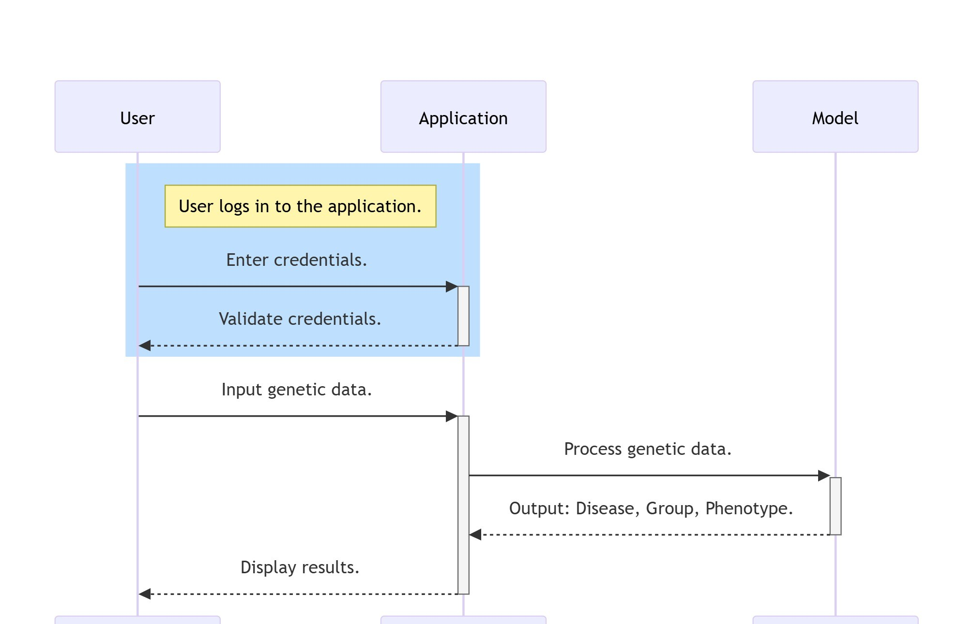
UML Diagram
Sequence Diagram

Slide 16
Data Preprocessing Techniques
1. Handling Missing Values
Numeric Features: Missing values in numerical columns like DSI, DPI, EI, YearInitial, and YearFinal are imputed using the median. This ensures that the dataset remains complete and consistent, allowing models to work effectively without introducing significant biases.
Categorical Features: Missing values in categorical columns, such as diseaseClass, are filled with a placeholder value ('unknown') to retain the categorical structure and prevent data loss.
2. Encoding Categorical Variables
Label Encoding: Categorical variables such as diseaseName and diseaseSemanticType are converted into numeric representations using Label Encoding. This transformation enables the machine learning models to process these variables effectively while preserving their categorical relationships.
3. Feature Scaling and Normalization
Normalization: Min-Max scaling or similar normalization techniques are applied to numerical features to ensure they lie within a comparable range. This prevents features with larger scales from dominating the model’s learning process and ensures all variables contribute equally.

Slide 17
Data Preprocessing Techniques
4. Clustering for Disease Categorization
KMeans Clustering: An unsupervised learning approach is used to group diseases into meaningful clusters based on diseaseName and diseaseSemanticType. For example:
Diseases are categorized into clusters like "Respiratory Diseases" or "Neurological Disorders" based on diseaseName.
Clusters like "General Diseases" or "Behavioral and Psychological" are derived using diseaseSemanticType.
Clustering enhances the interpretability of the dataset and helps identify patterns in disease relationships, providing an additional layer of organization and analysis.
5. Train-Test Split
The preprocessed data is split into training and testing sets using train_test_split, ensuring 70% of the data is used for training and 30% for evaluation. This step prepares the data for model training and validation.

Slide 18
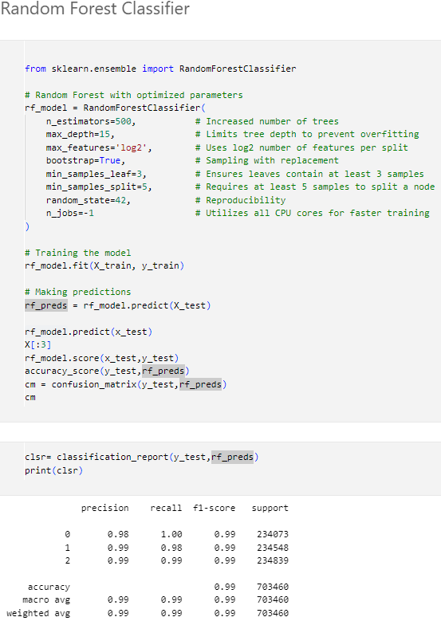
Sample Code

Slide 19
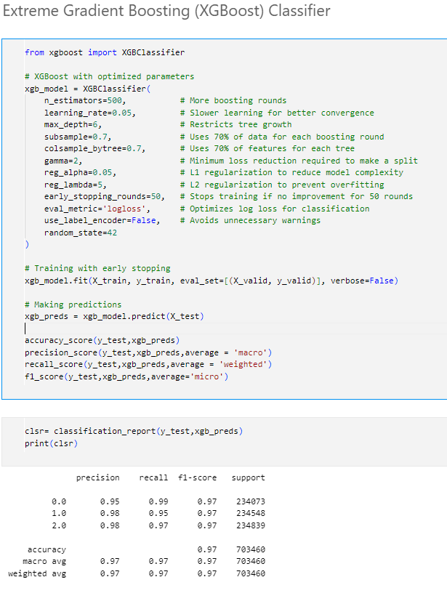
Sample Code

Slide 20
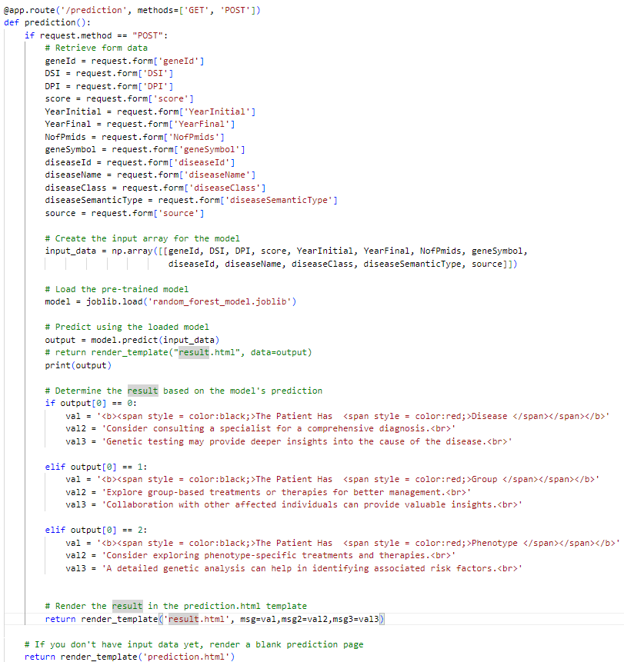
Sample Code

Slide 21
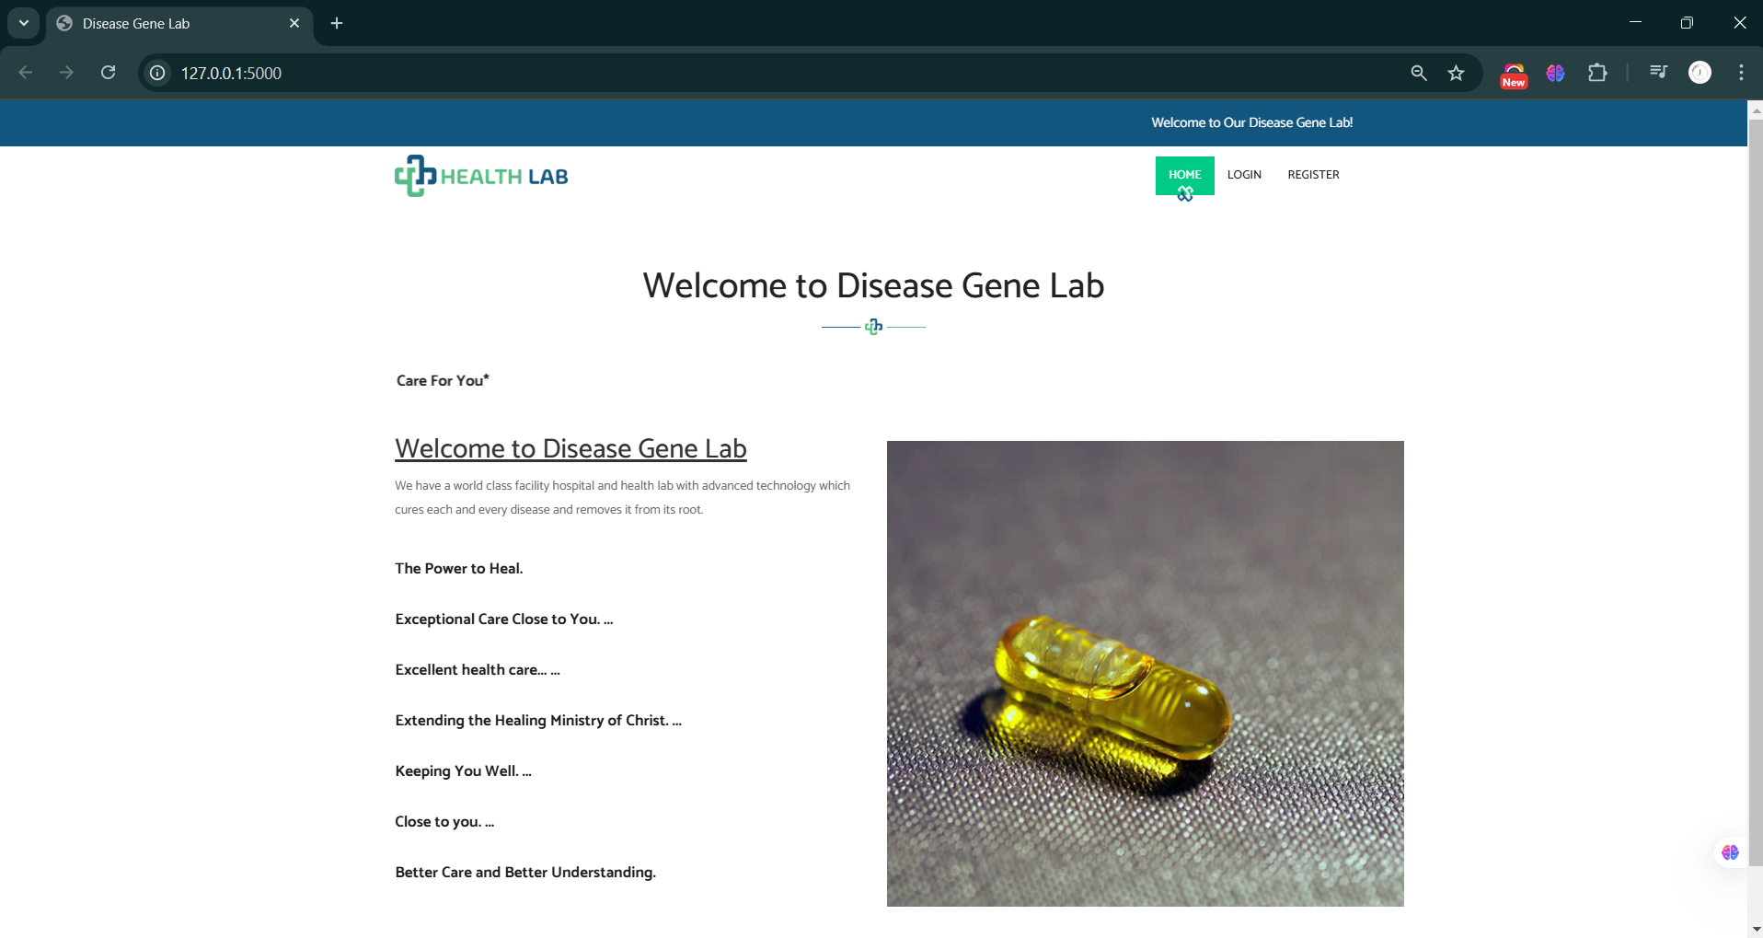
Project output

Slide 22
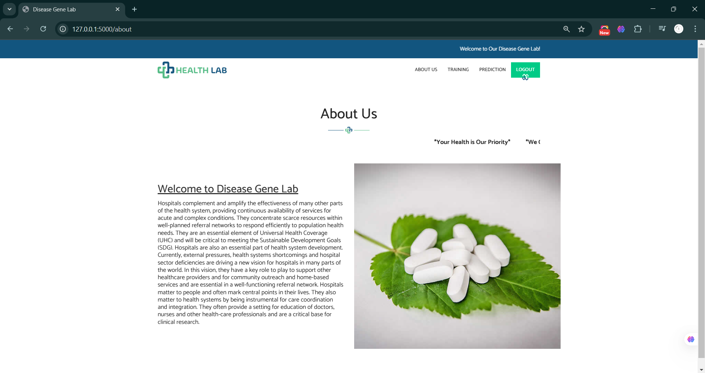
Project output

Slide 23
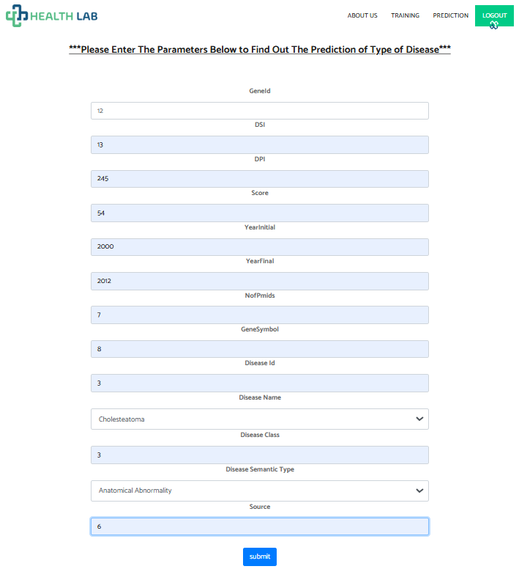
Project output

Slide 24
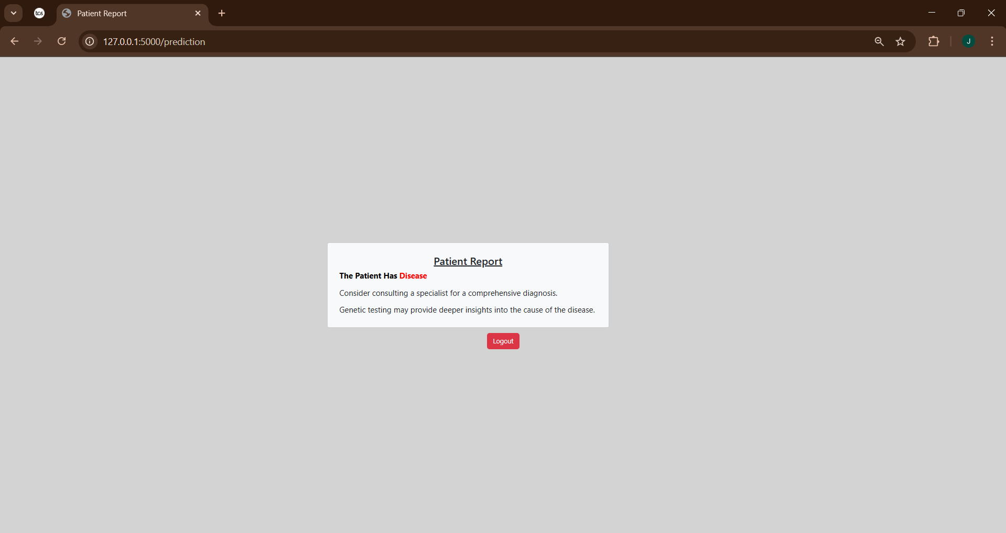
Project output

Slide 25
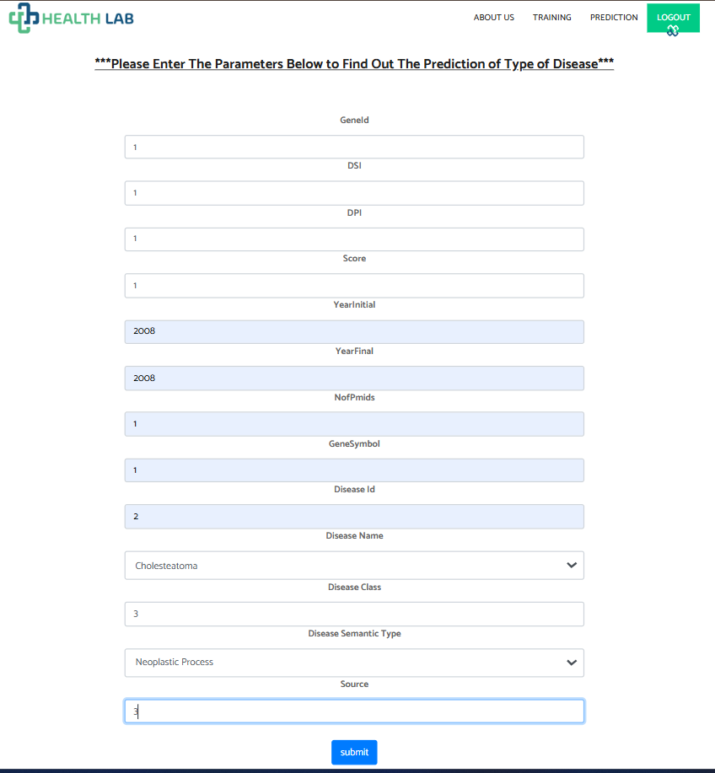
Project output

Slide 26
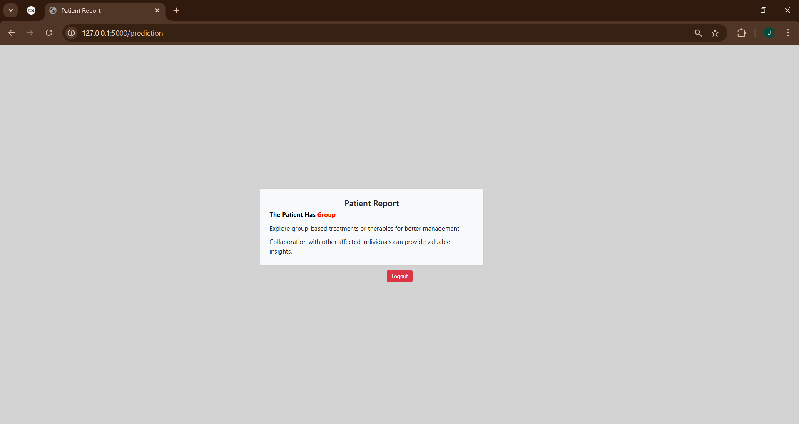
Project output

Slide 27
Reference
[1] U. M. Singh-Blom, N. Natarajan, A. Tewari, J. O. Woods, I. S. Dhillon, and E. M. Marcotte, “Prediction and Validation of Gene-Disease Associations Using Methods Inspired by Social Network Analyses,” PLoS One, vol. 8, no. 5, p. e58977, May 2013, doi: 10.1371/JOURNAL.PONE.0058977.
[2] H. Yang, Y. Ding, J. Tang, and F. Guo, “Identifying potential association on gene-disease network via dual hypergraph regularized least squares,” BMC Genomics, vol. 22, no. 1, pp. 1–16, Dec. 2021, doi: 10.1186/S12864-021-07864-Z/TABLES/9.
[3] Andrea Mastropietro, Gianluca De Carlo, Aris Anagnostopoulos, “XGDAG: Explainable Gene–Disease Associations via Graph Neural Networks”, Bioinformatics, vol. 39, issue. 8, 2023, doi: 10.1093/bioinformatics/btad482
[4] X. Jia et al., “A deep learning framework for predicting disease-gene associations with functional modules and graph augmentation,” BMC Bioinformatics, vol. 25, no. 1, pp. 1–14, Dec. 2024, doi: 10.1186/S12859-024-05841-3/TABLES/2.

Slide 28
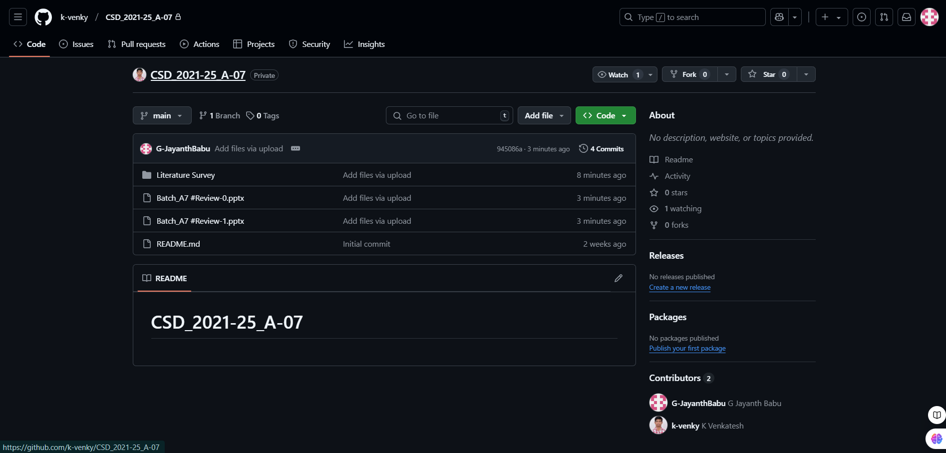

Git Hub Dashboards of each student
Repository Name Like: CSD 2024 – 25 Batch: A – 07

Slide 29
Any Queries?

Slide 30
Thank You!!!

